Slide 1
Data Science Intern Challenge
Data-Driven Insights for Citi Bike: Optimizing Business Growth & Cost Efficiency
Md Ekram Hossain, Data Science Intern Candidate
16.09.2024

Slide 2
This is an agenda. In blue.
01
About Me
02
Data Overview
03
Exploratory Data Analysis (EDA)
04
Predictive Modelling

Slide 3
This is an agenda. In blue.
05
Business Growth Opportunities & Cost Optimization Strategies
06
Recommendations
07
Conclusion
08
Q&A

Slide 4








About Me
Education:
Born & raised
2021: Completed B.Sc. in Software Engineering
2022: Started M.Sc. in Data Science at FAU
Dhaka , Bangladesh
Projects:
Analyzer.App
Web Application for Automated Machine Learning Analysis
COVID-19 Cases Prediction and Analysis
Time Series Forecasting and Machine Learning for Pandemic Trend Analysis
Pizza Delivery Analysis Process Mining – Celonis
Power BI Dashboard for Call Center Analytics
Analysis Dashboard
Working Experience:
Working Student – Data Analyst
Elektrobit Automotive GmbH - Erlangen
Sep 2022 – Mar 2024
Research Assistant
Daffodil International University - Dhaka
Jan 2019 – Mar 2021
Md Ekram Hossain
Master’s Thesis Student at Elektrobit
Portfolio
Research Publications
Personal Interests
Published 6 research articles in different international conference and journal ResearchGate
Travelling
Football
Cricket

Slide 5


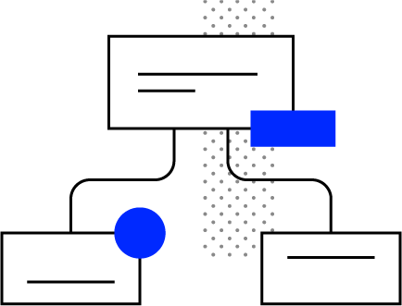

Data Science Intern Application at Celonis
Why This Role Excites Me:
Relevant Experience : Worked as a Data Analyst at Elektrobit Automotive GmbH, leading automation projects that increased operational efficiency by 40%.
Passion for Process Mining : I have a strong interest in discovering process inefficiencies and streamlining workflows, which is directly aligned with Celonis' mission.
Knowledge : Python, SQL, Machine Learning, Data Visualization, Web Development, Automation, Uni-Course: Process Orientation and Information System.
My Goals for This Role:
Contribution : Bring data-driven process insights to the team and help solve complex problems.
Growth : Develop expertise in AI-driven decision-making with process mining, and contribute to impactful projects.
Learning : I’m eager to collaborate with industry experts and refine my skills in real-world applications

Slide 6
Data Science Intern Challenge Task

Slide 7
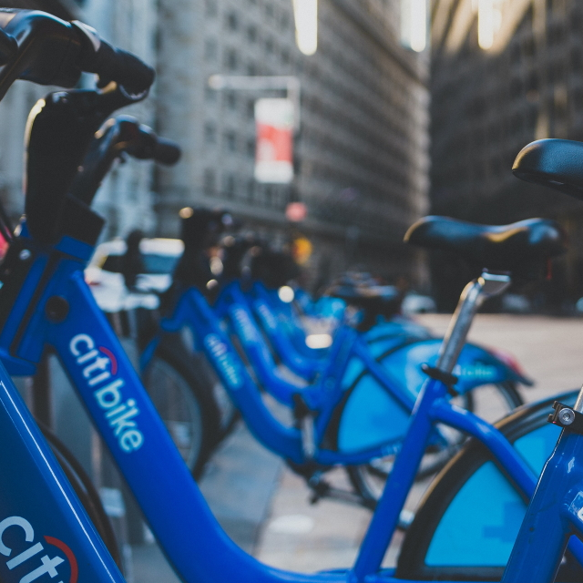
Data Overview
Data Sources: Citi Bike System Data , Operating Reports
Link : JC-202407-citibike-tripdata.csv.zip - July 2024
Dataset Features:
Ride ID, Rideable type, Started at, Ended at, Start station name, Start station ID, End station name, End station ID, Start latitude, Start longitude, End latitude, End Longitude, Member or casual ride - Total Features -: 13
- Total Rows -: 112443
Data Pre-processing:
Data cleaning: Handling missing values, outliers, etc.
Feature engineering: Created variables like "ride length", "ride frequency", "distance", etc.

Slide 8
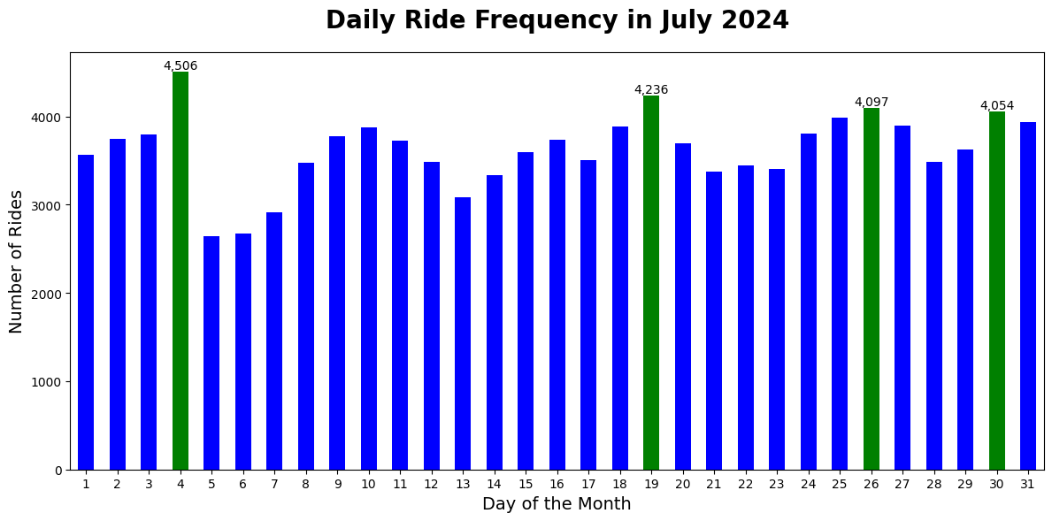
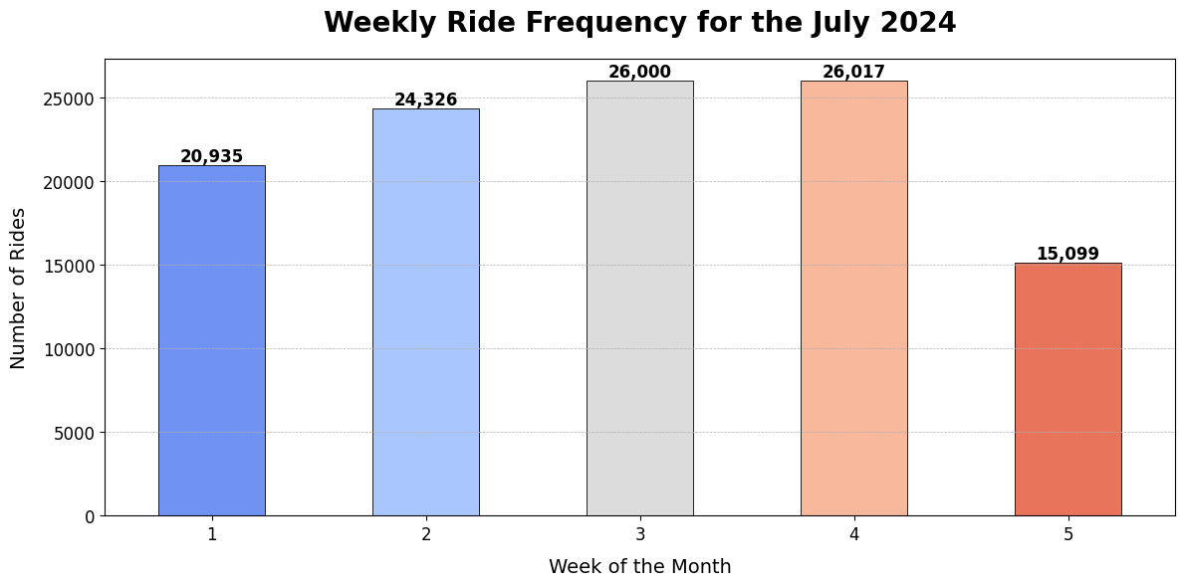
Daily and Weekly Ride Patterns
Objective:
A focused view of ride patterns in July 2024 by examining daily and weekly trends, highlighting periods of peak activity.
Daily Ride Frequency:
July 4th (4,506 rides): Likely influenced by national holiday celebrations (Independence Day).
July 19th (4,236 rides) and July 26th (4,097 rides): Potential correlations with local events or promotions.
July 30th (4,054 rides): Tourist Activity, Concerts, Summer Streets
Weekly Ride Frequency:
The 4th week of July saw the highest number of rides, with 26,017 rides. The 5th week shows a notable drop-off, with 15,099 rides due to less day for last week.
The middle weeks (Week 2, Week 3, and Week 4) show consistently higher demand, indicating that mid-month is more active.

Slide 9
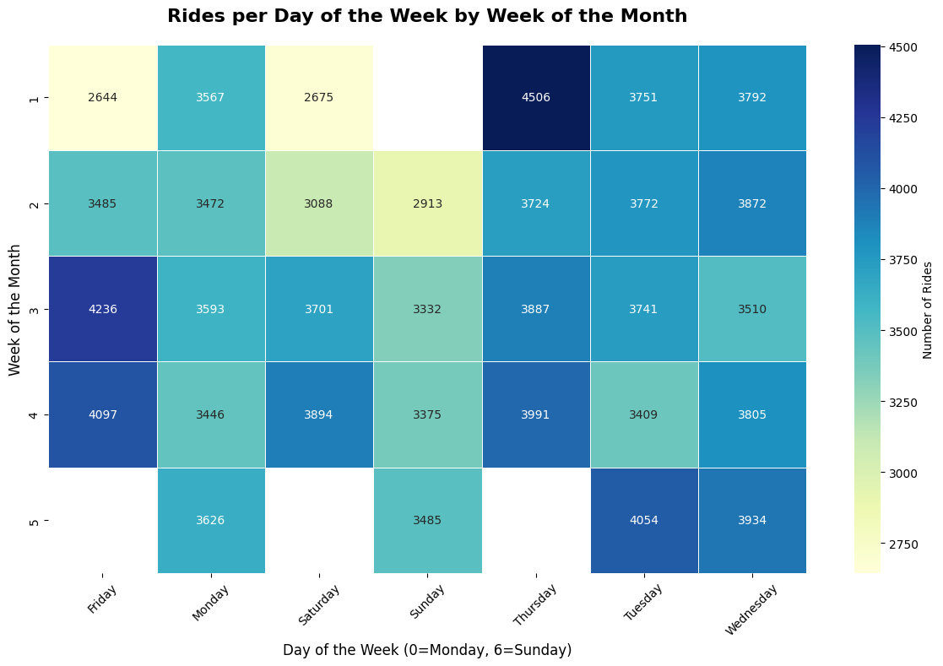
Daily and Weekly Ride Patterns
Objective:
A focused view of ride patterns in July 2024 by examining daily and weekly trends, highlighting periods of peak activity.
Daily Ride Frequency:
July 4th (4,506 rides): Likely influenced by national holiday celebrations (Independence Day).
July 19th (4,236 rides) and July 26th (4,097 rides): Potential correlations with local events or promotions.
July 30th (4,054 rides): Tourist Activity, Concerts, Summer Streets
Weekly Ride Frequency:
The 4th week of July saw the highest number of rides, with 26,017 rides. The 5th week shows a notable drop-off, with 15,099 rides due to less day for last week.
The middle weeks (Week 2, Week 3, and Week 4) show consistently higher demand, indicating that mid-month is more active.

Slide 10
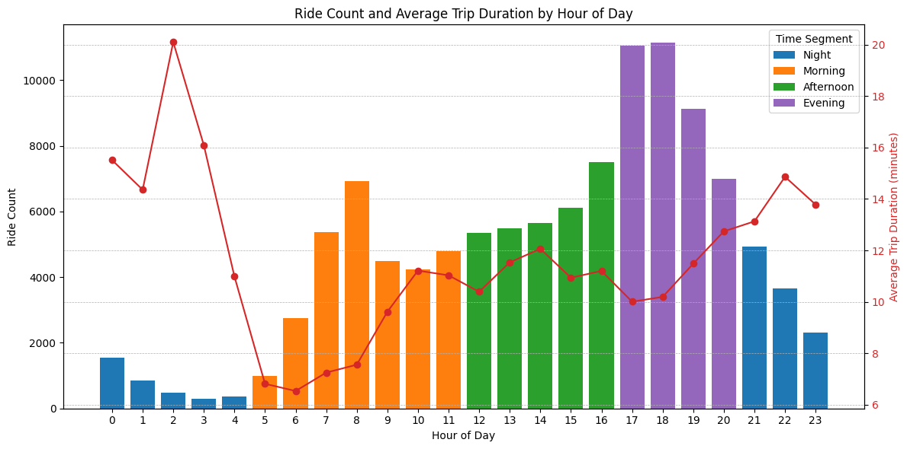
Hourly Ride Patterns
Evening Peak (5 PM - 8 PM):
The evening hours show the highest ride counts, with the peak at 5 PM (~10,000 rides). This is most likely driven by commuters heading home or engaging in post-work activities. The average trip duration about 11-13 minutes during this time
The sustained high ridership between 5 PM and 7 PM suggests a mix of both commuting and leisure-related activities.

Slide 11
Hourly Ride Patterns
Morning Peak (5 AM - 11 AM):
The morning commute also shows a significant spike in ridership, particularly between 7 AM and 11 AM, peaking at 8 AM (~7,000 rides). morning trips are shorter, averaging 8 -10 minutes.
This pattern is typical for weekday mornings, with riders commuting to work or connecting to other public transportation.

Slide 12
Hourly Ride Patterns
Afternoon Stability (12 PM - 4 PM):
The afternoon period demonstrates a stable and moderate ridership (~5,000–7,000 rides), indicating a mix of leisure rides and short-distance trips, averaging 10-12 minutes .
This period suggests less work-related travel and more casual or recreational usage of bikes, possibly from tourists or locals out for a ride.

Slide 13
Hourly Ride Patterns
Night-time Dip (9 PM - 4 AM):
There’s a significant drop in ride count during the late-night hours, with less than 2,000 rides per hour between 12 AM and 4 AM.
Despite the low ride count, trip durations are longer, averaging 15-18 minutes. Riders at this time may be using bikes for leisure rides, or they may be traveling greater distances to return home after late-night activities.

Slide 14
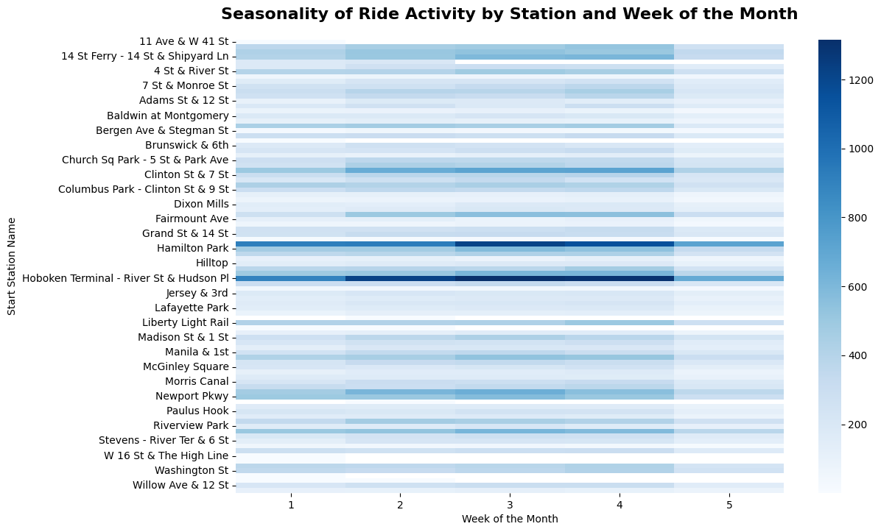
Ride Activity by Station and Week of the Month
Station with Highest Ride Activity:
Hoboken Terminal - River St & Hudson Pl is the busiest station consistently throughout the month
This station is likely a major transportation hub.
Low Activity Stations:
Several stations such as Baldwin at Montgomery and Brunswick & 6th show relatively lighter activity.
These stations may be located in residential areas or places with less tourist or commuter traffic.
Concentration of Activity at Major Transit Points:
Stations near transit hubs such as Hoboken Terminal and Washington St demonstrate higher ride activity, likely due to their proximity to train or ferry services.

Slide 15
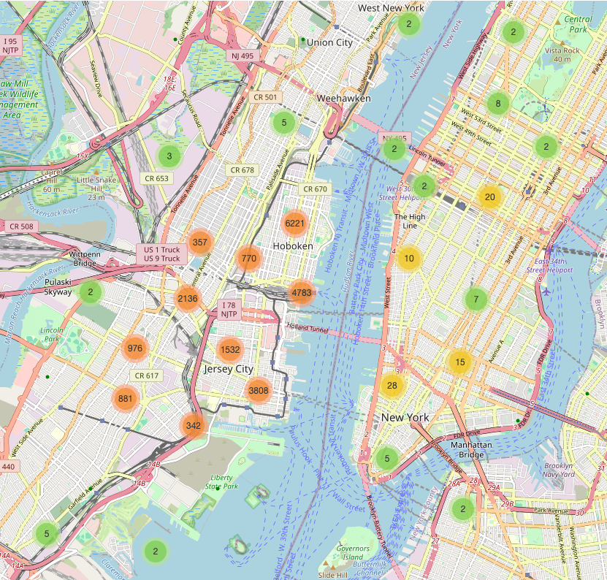
High-Demand Stations:
Hoboken: The Hoboken Terminal area has a significant concentration of activity, as seen by clusters with 6,221 and 4,783 rides. This station is likely a key transit hub.
Jersey City: Similar trends are visible, with clusters showing 3,808 and 1,532 rides.
Heatmap of Bike Rides Across New York City

Slide 16
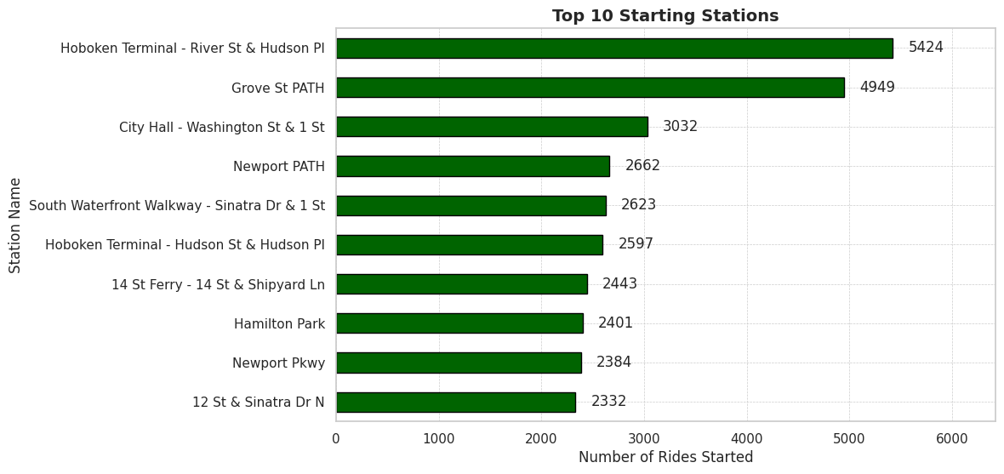
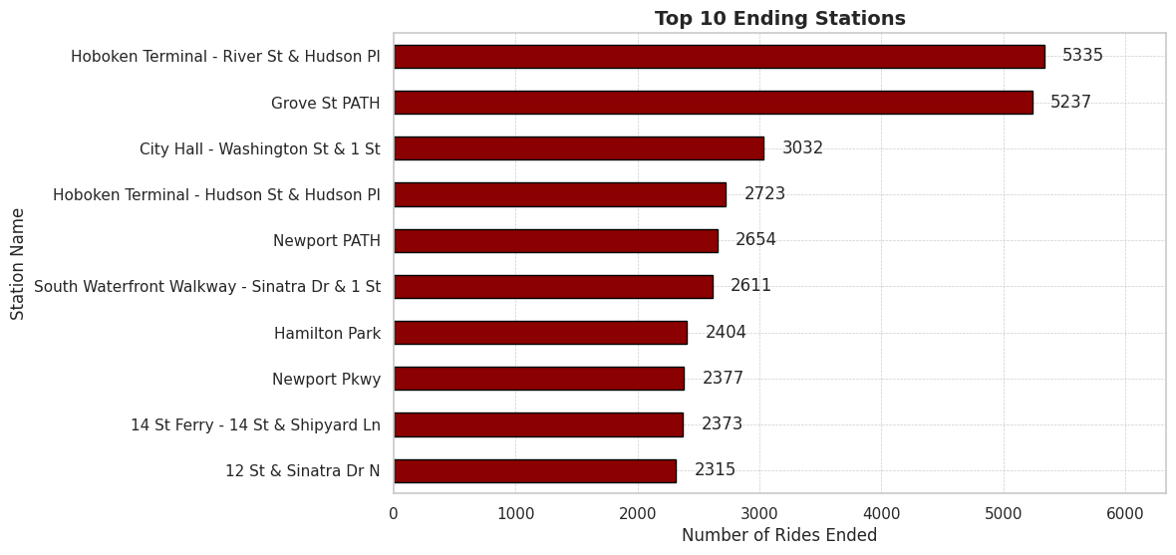
Stations for Bike Traffic: Starts vs Ends
Dominant Hubs: Hoboken Terminal leads in both starting and ending rides, showing its significance as a central node for commuters and local travellers.
Grove St PATH is the second most trafficked station, highlighting the importance of maintaining and growing infrastructure in this area.
Consistent Stations: City Hall (Washington St & 1 St) ranks consistently across both metrics, indicating balanced inflow and outflow of bikes.

Slide 17
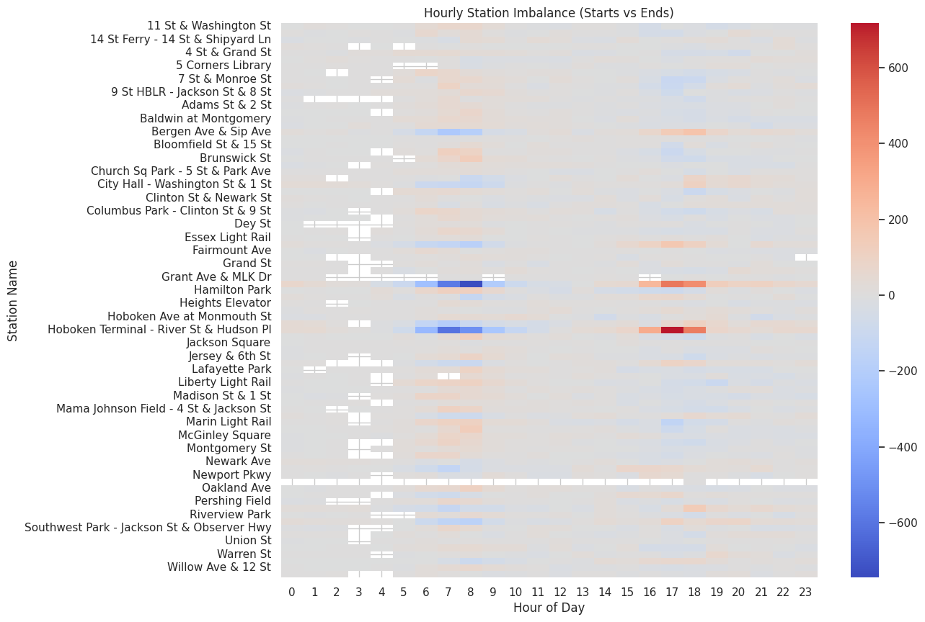
Hourly Bike Inflow and Outflow by Station
Inflow: Refers to bikes arriving at a station (rides ending).
Outflow: Refers to bikes leaving from a station (rides starting).
Imbalance: The difference between inflow and outflow at various hours of the day and across different stations is shown through colour intensity:
Red represents a higher inflow than outflow (more bikes arriving than leaving).
Blue represents a higher outflow than inflow (more bikes leaving than arriving).

Slide 18
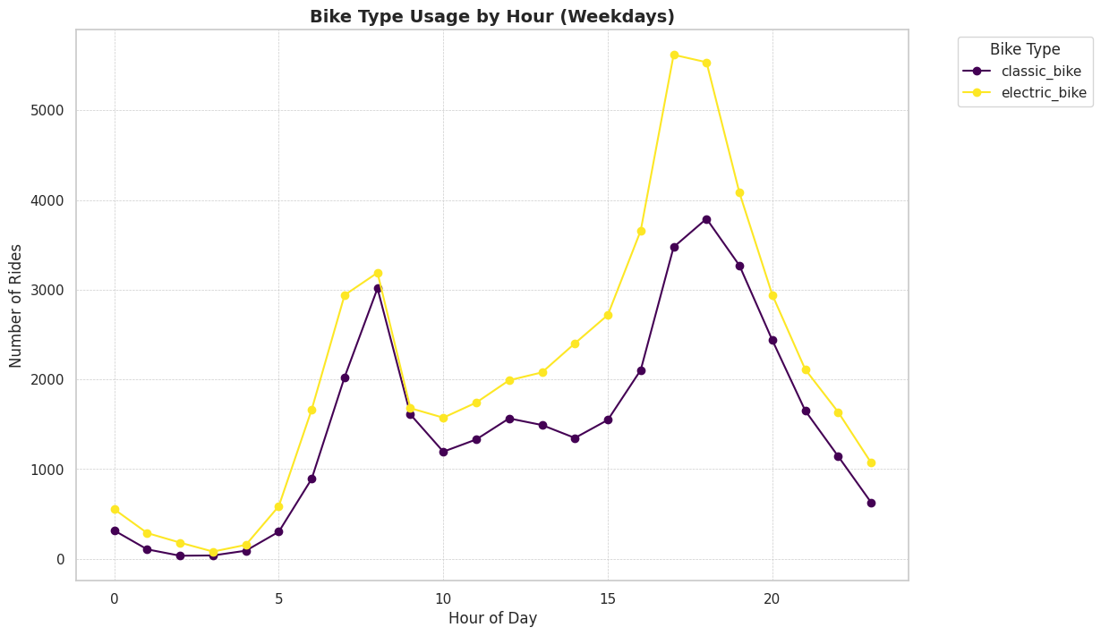
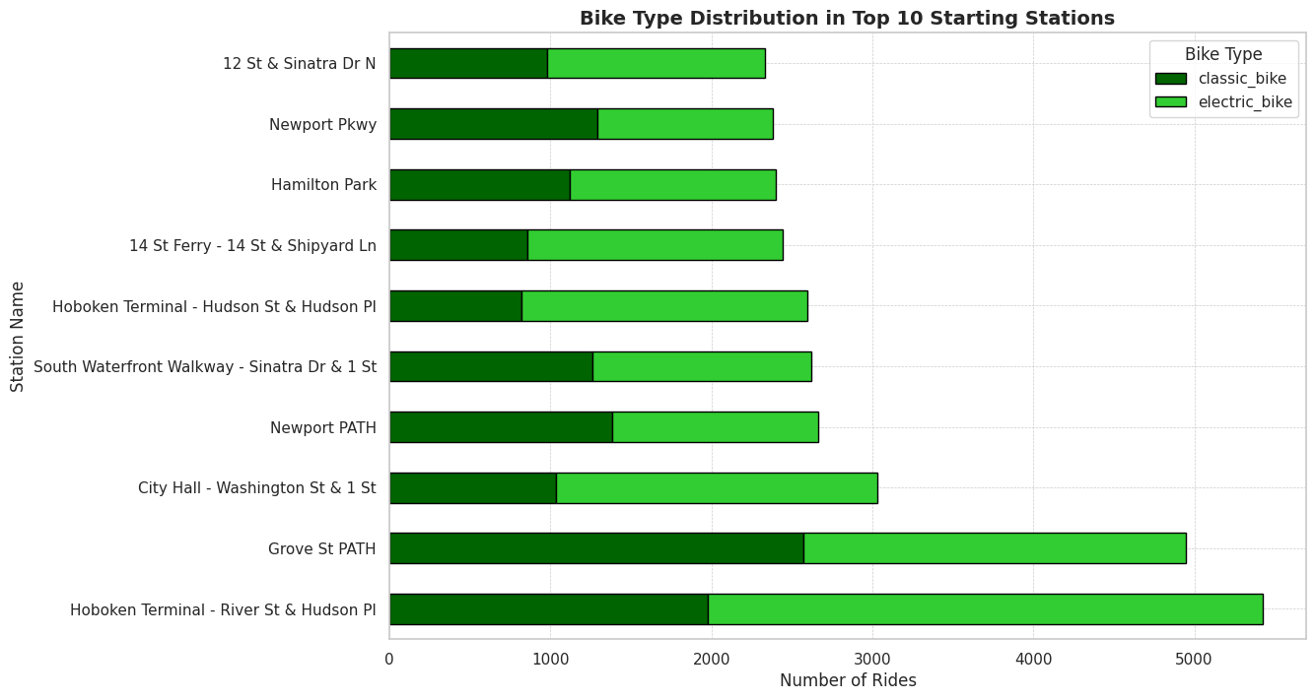
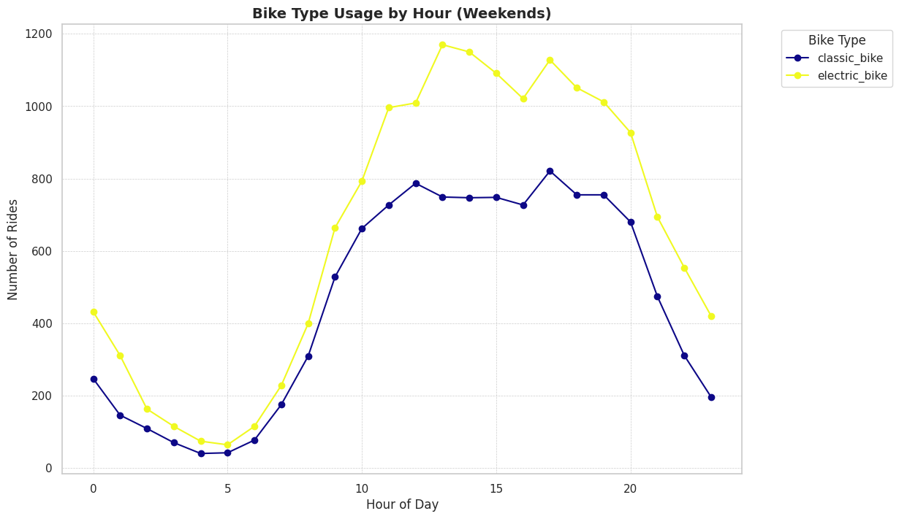
Bike Type Usage Analysis: Weekdays vs Weekends
Weekday Patterns:
Electric bikes have a noticeable spike during the morning (7-9 AM) and evening (4-6 PM) rush hours, likely reflecting commuter behaviour.
Classic bikes see relatively lower usage but follow similar time trends, showing consistent demand across the day.
Weekend Patterns:
Electric bikes are more popular in the late morning and afternoon, peaking between 11 AM and 5 PM, likely reflecting leisure activities.
Classic bikes follow a similar trend but see less overall usage compared to electric bikes, suggesting that users prefer electric bikes for longer or more frequent trips during the weekends.
Top 10 Stations for Electric Bikes:
Hoboken Terminal and Grove St PATH have the highest demand for electric bikes.

Slide 19
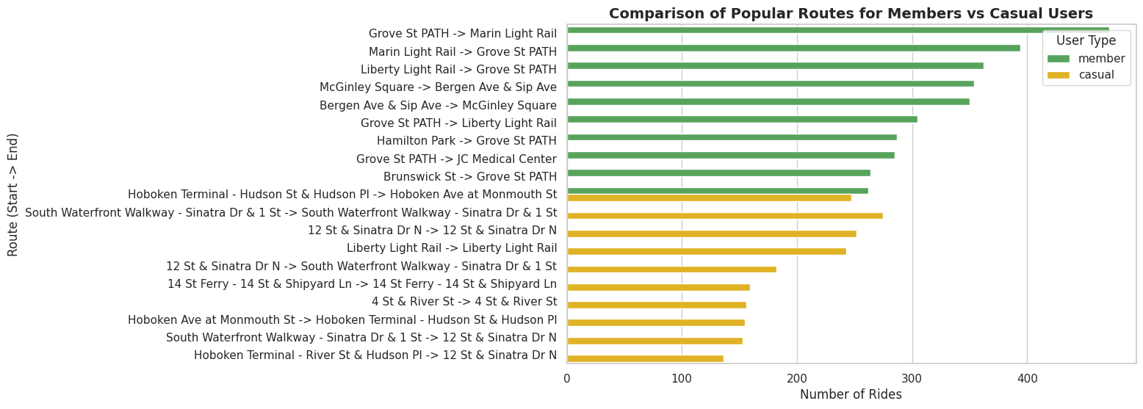
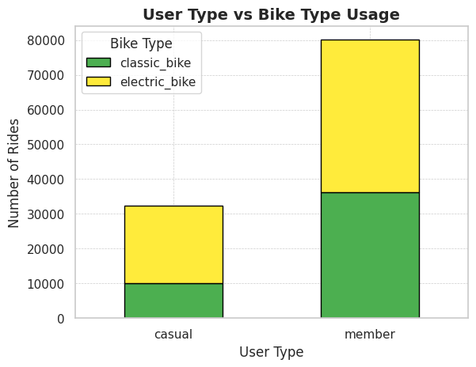
Popular Routes Comparison: Members vs Casual Users
Members:
The most popular route for members is Grove St PATH → Marin Light Rail and Marin Light Rail → Grove St PATH, showing a strong preference for connectivity between major transport hubs.
Other high-frequency routes also centre around Liberty Light Rail and McGinley Square, indicating members frequently use these stations as commuting points.
Casual Users:
The top route for casual users is Hoboken Terminal → Hudson St & Hudson Pl → Hoboken Ave at Monmouth St.
Casual riders seem to favour scenic or tourist-friendly routes like South Waterfront Walkway and Hoboken Terminal.
User Type vs. Bike Type Usage:
Members dominate in both classic and electric bike usage, particularly electric bikes.
Casual Users prefer electric bikes more proportionally than members.

Slide 20
Predictive Modelling: Ride Demand Prediction
Remove Null Values
Datatype Formatting
Hourly data conversion
Training – 80%
Testing – 20%
Fine Tuning
SHAP
Feature Importance
Data Extraction
Data Preprocessing
Feature Engineering
Split Training-Testing Dataset
ML Algorithms
Model Explanation
Model Evaluation
Jan 2024 - Aug 2024
Add session
Add day type
Add time segment
RMSE
R2
MSE

Slide 21
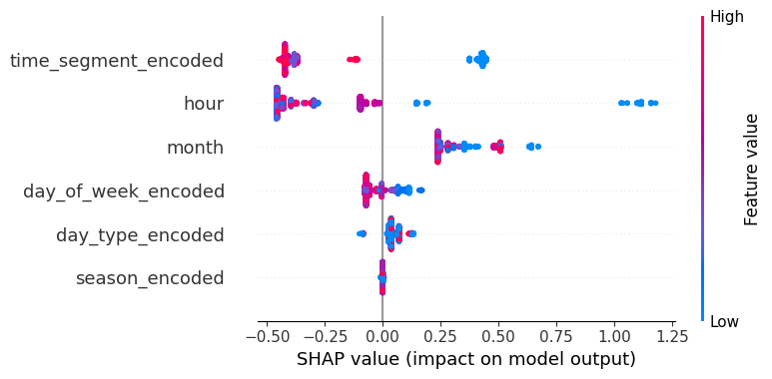
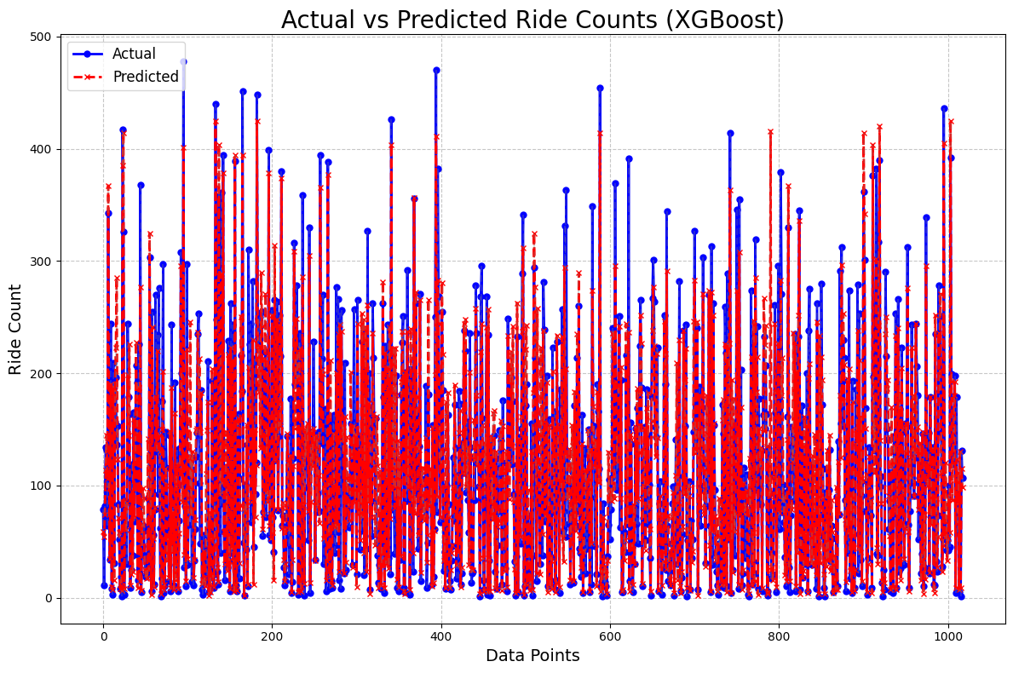
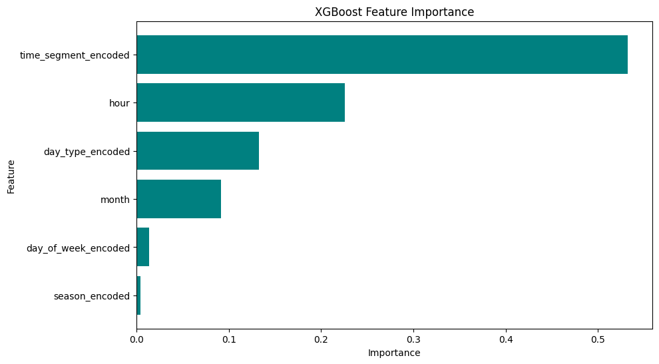
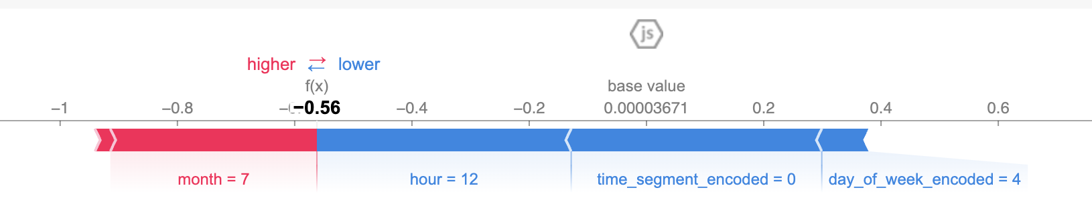
Model Evaluation
 | Algorithm | Train RMSE | Train R² | Train MAE | Test RMSE | Test R² | Test MAE | Time (s)
0 | Ridge | 0.731936 | 0.464270 | 0.544393 | 0.764556 | 0.437996 | 0.570968 | 0.095118
1 | Lasso | 0.732339 | 0.463680 | 0.544128 | 0.763486 | 0.439568 | 0.568792 | 0.093959
2 | ElasticNet | 0.731970 | 0.464220 | 0.544252 | 0.764332 | 0.438325 | 0.570426 | 0.219262
3 | RandomForest | 0.329573 | 0.891382 | 0.205043 | 0.381812 | 0.859842 | 0.245499 | 135.831534
4 | GradientBoosting | 0.345676 | 0.880508 | 0.219953 | 0.377586 | 0.862927 | 0.244289 | 84.114760
5 | XGBoost | 0.339084 | 0.885022 | 0.211853 | 0.374902 | 0.864869 | 0.240504 | 19.247043
ML Algorithms Evaluation Results
Model Prediction (Actual Vs Predicted)
Features Importance by Xgboost
Model Explainability with Shap

Slide 22
Key Recommendations
Expand Fleet and Stations in High-Demand Areas Stations like Hoboken Terminal and Grove St PATH should have more electric bikes to meet the growing demand.
Launch Seasonal Promotions and Incentives Introduce seasonal campaigns during high-demand months and targeted promotions for weekends to boost usage.
Implement Dynamic Pricing Use dynamic pricing during peak demand hours (morning and evening) to manage demand and increase revenue.
Right-Size the Fleet Based on Demand Reduce the number of bikes at low-demand stations and increase availability at high-demand stations.
Targeted Maintenance Scheduling Prioritize electric bikes for maintenance as they have higher usage, ensuring minimal downtime during peak hours.
Increase Membership Conversions Provide membership incentives for casual users, offering them benefits like discounted electric bike

Slide 23
Overall Challenges in Data Processing and Modelling
Data Quality Issues
Time-Related Data Complexity
Feature Engineering
Encoding Categorical Variables
Scaling and Normalization
Model Selection and Hyperparameter Tuning
GridSearchCV
Model Interpretability

Slide 24
Q&A

Slide 25
Thank you.
Contact details Md Ekram Hossain
M.Sc. In Data Science at University of Erlangen-Nuremberg
Email: ekramml0013@gmail.com
Mobile: +49 1747349263

